Slide 1

HiP-CT Vasculature Segmentation: AI-Driven Precision for Cellular Senescence Analysis
Team 135
Mohammed Sami MK (mamk)
Mushtaq Ahmed Shaikh (mshaikh2)
Seungmin Lee (slee93)

Slide 2
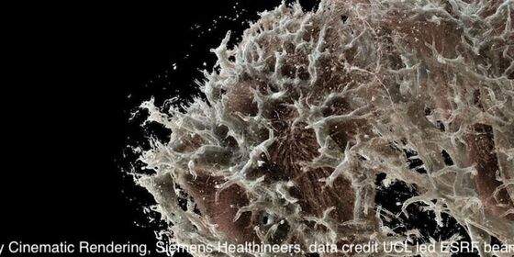
Motivation
This project aims to enhance the Vasculature Common Coordinate Framework (VCCF) by using data science to automate the segmentation of vasculature from high-resolution images. Currently reliant on laborious manual annotations, our work could transform the understanding of how cells and vasculature interact, improving models of blood flow and cellular location across different ages, sexes, and body conditions. This effort is crucial for advancing the comprehensive atlases under the SenNet and Human Organ Atlas initiatives, which inform medical science about cellular dynamics and human anatomy.

Slide 3
Task for this project
What we aim to achieve through this project is:
Develop a model to segment blood vessels using 3D Hierarchical Phase-Contrast Tomography (HiP-CT) data from human kidneys, aiming to enhance the representation of vasculature in the human body.

Slide 4
Data set
Our dataset comprises high-resolution 3D images of several kidneys together with 3D segmentation masks of their vasculature.
The kidney images were obtained through Hierarchical Phase-Contrast Tomography (HiP-CT) imaging. HiP-CT is an imaging technique that obtains high-resolution (from 1.4 micrometers - 50 micrometers resolution) 3D data from ex vivo organs.

Slide 5
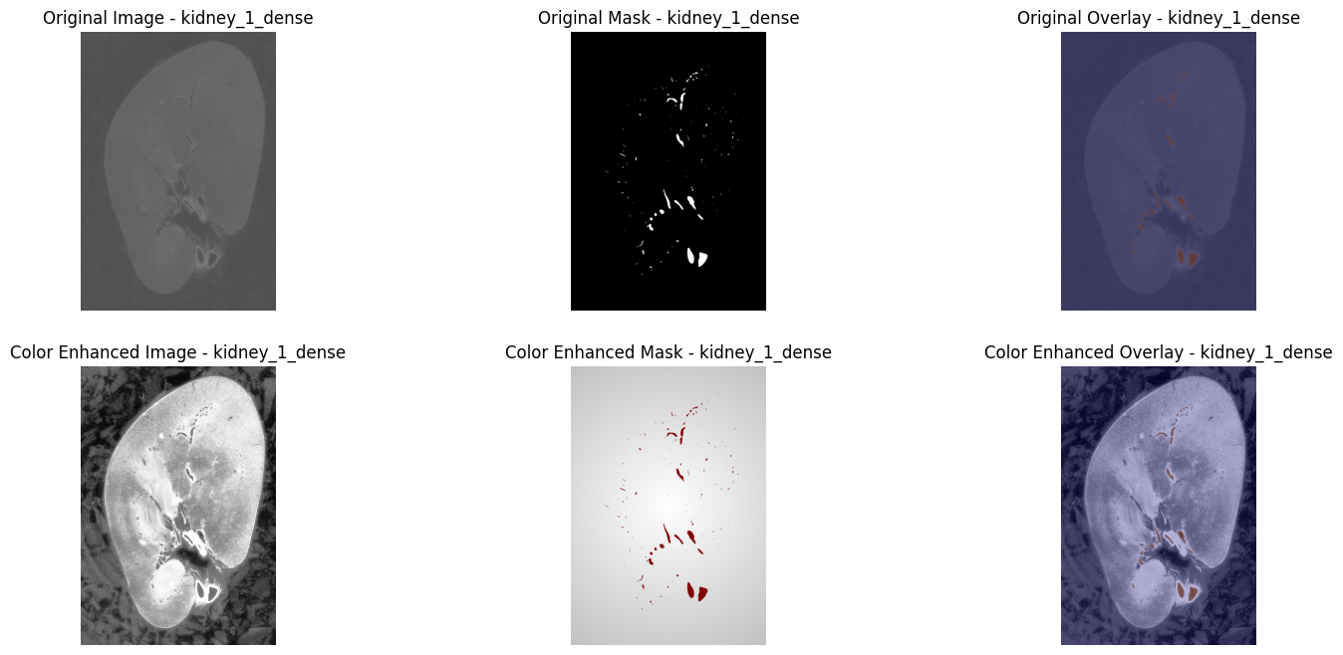
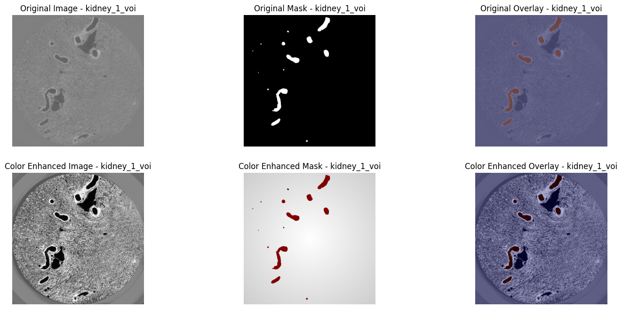
kidney_1_dense
Data set
kidney_1_dense - The whole of a right kidney at 50um resolution. The entire 3D arterial vascular tree has been densely segmented, down to two generations from the glomeruli (i.e. the capillary bed). Uses beamline BM05.
kidney_1_voi - A high-resolution subset of kidney_1, at 5.2um resolution.
kidney_1_voi

Slide 6
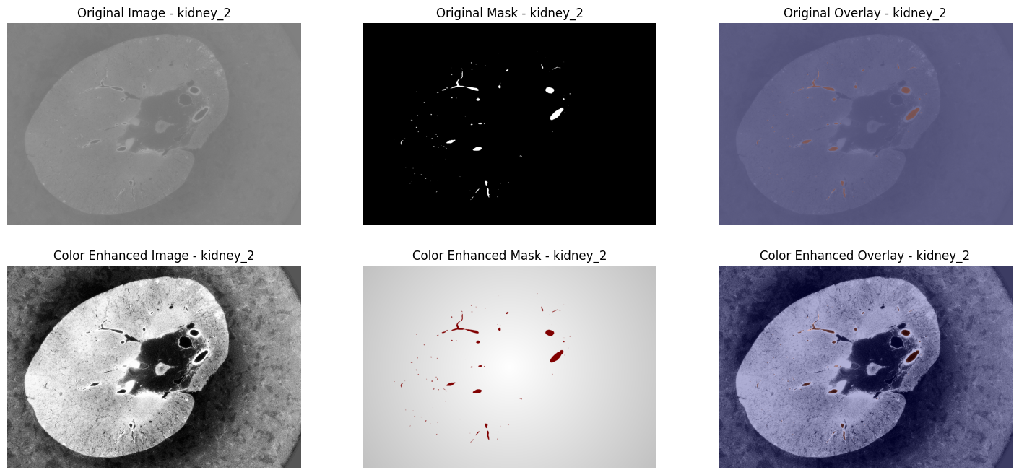
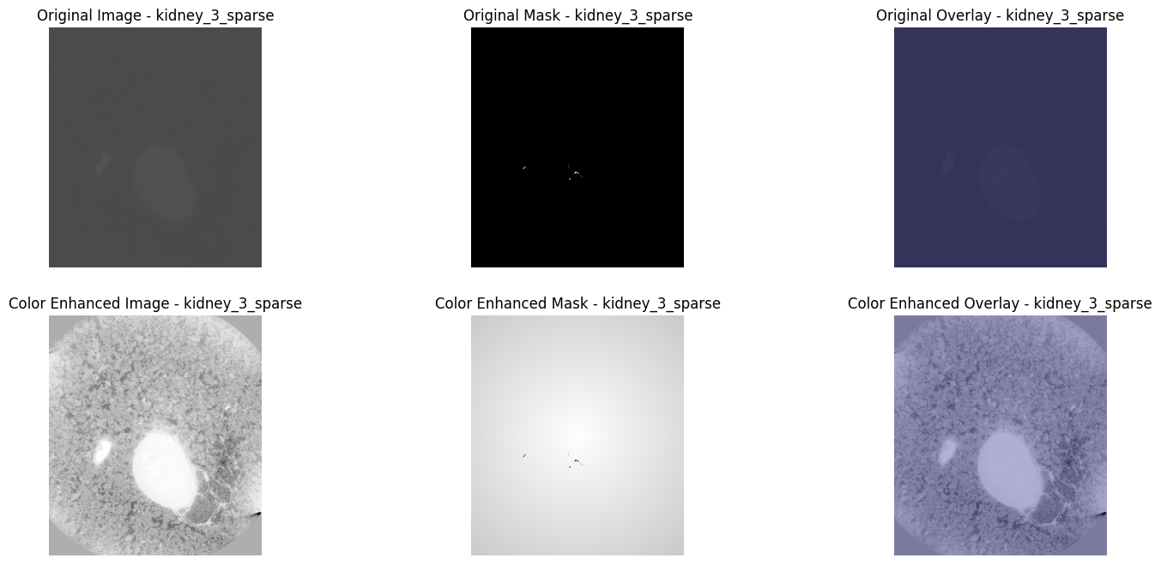
kidney_2
Data set
kidney_2 - The whole of a kidney from another donor, at 50um resolution. Sparsely segmented (about 65%).
kidney_3_dense - A portion (500 slices) of a kidney at 50.16um resolution using BM05. Densely segmented.
kidney_3_sparse - The remainder of the segmentation masks for kidney_3. Sparsely segmented (about 85%).
kidney_3_sparse

Slide 7
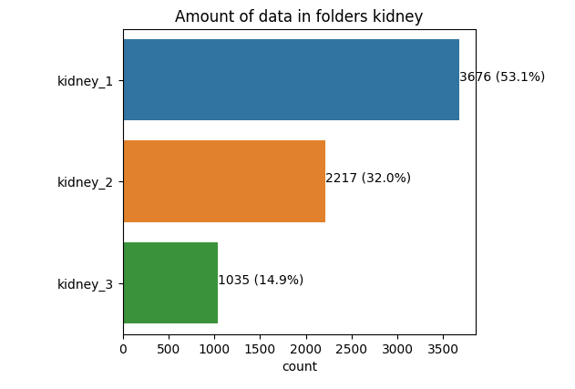
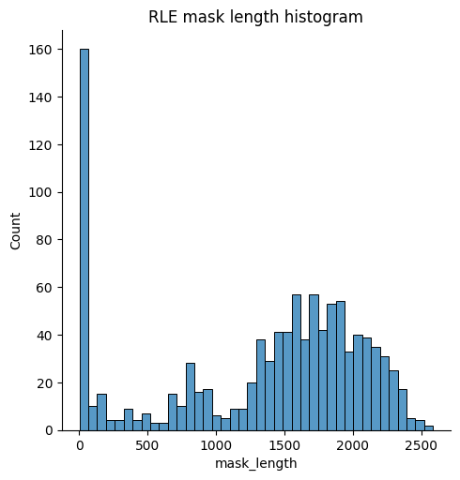
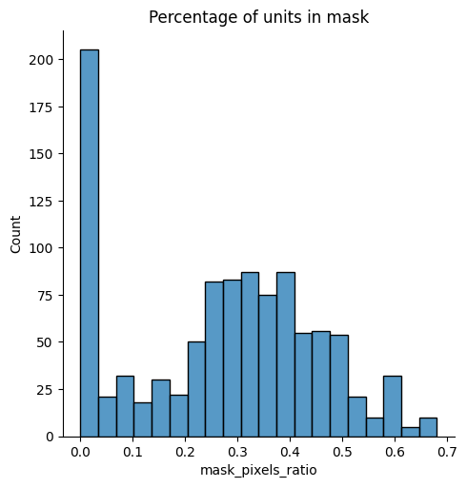
Data set
Pictures of different kidneys have different sizes.
The datasets are of different size.
The size of the segmentation mask is small.
kidney_3_sparse

Slide 8
Baseline Model
Our baseline model utilizes a ResNet architecture designed for binary image segmentation, combining convolutional layers, batch normalization, and residual blocks for enhanced feature extraction.
Our training involves 20 epochs with a batch size of 4, integrating class weights to address data imbalance and early stopping to fine-tune the validation Dice coefficient. This strategy forms a comprehensive and tailored approach to binary image segmentation.

Slide 9
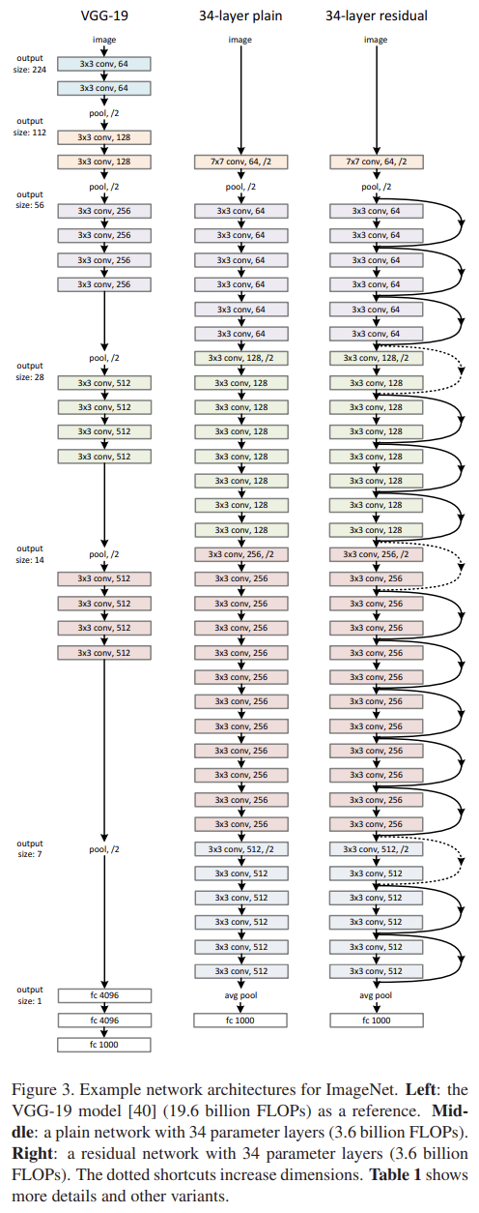
ResNet
VGG-19: Utilizes deep convolutional layers and a large number of parameters for high-resolution feature extraction, but suffers from high computational complexity and a risk of overfitting.
Plain Network: Simplifies VGG's design, reducing the number of filters and computational complexity to provide a more economical and efficient model.
Residual Network (ResNet): Adds shortcut connections to solve the training problems of deep networks, maintaining computational efficiency while enabling deeper learning.

Slide 10
The metric used in the baseline
Precision, Recall, F1-score
Confusion Matrix: This tool visualizes the performance of an algorithm by displaying true positives, false positives, true negatives, and false negatives.
Dice Coefficient: This metric assesses the similarity between two datasets, specifically comparing the predicted segmentation to the ground truth.

Slide 11
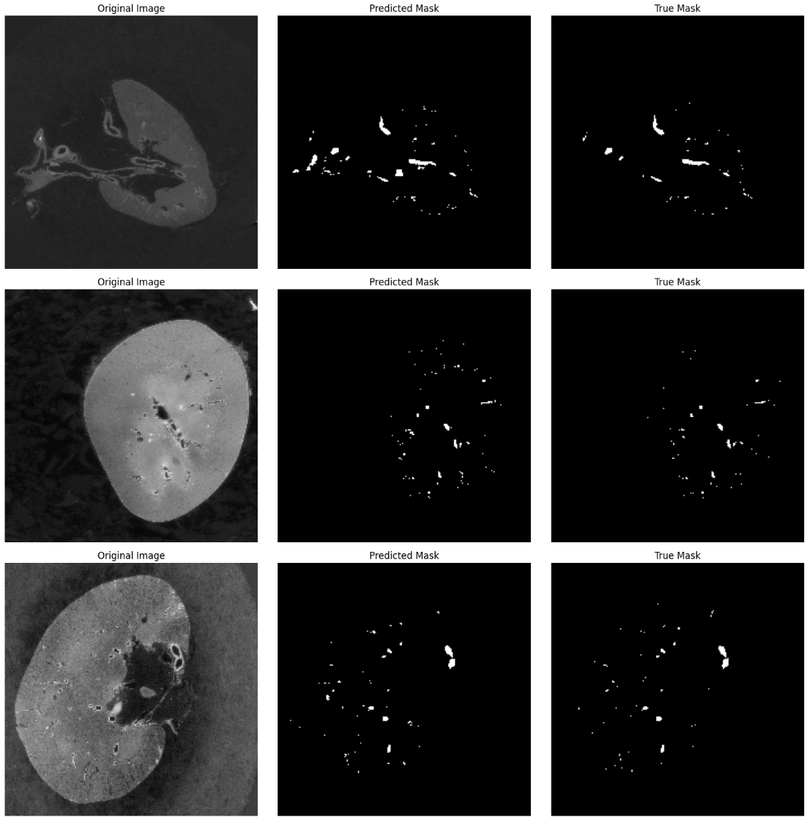
Input images
Predicted images
Ground truth
Baseline Result

Slide 12
Baseline Result
Our ResNet-based image segmentation model is a clear winner when compared to random guessing. Its advanced architecture, including the ResNet framework for deep, effective learning, and our custom BCE Dice Loss function optimized for segmentation accuracy, contribute to its superior performance.
The use of precision, recall, and F1-score as metrics further demonstrates the model's effectiveness beyond random outputs. Our strategic use of class weights and early stopping is a testament to our model's ability to prevent overfitting and address data imbalances, a feat that random guessing cannot achieve.

Slide 13
Improvised Model
We overcome this problem by previous basic ResNet model.
Our baseline model lacks the capability to provide pixel-level precision and detailed localization necessary for image segmentation tasks.
Also, it does not effectively utilize multi-scale features, limiting its ability to recognize complex image patterns across varying resolutions.
We attempted to overcome these limitations through the encoder-decoder structure and skip connections of the ResUNet.

Slide 14
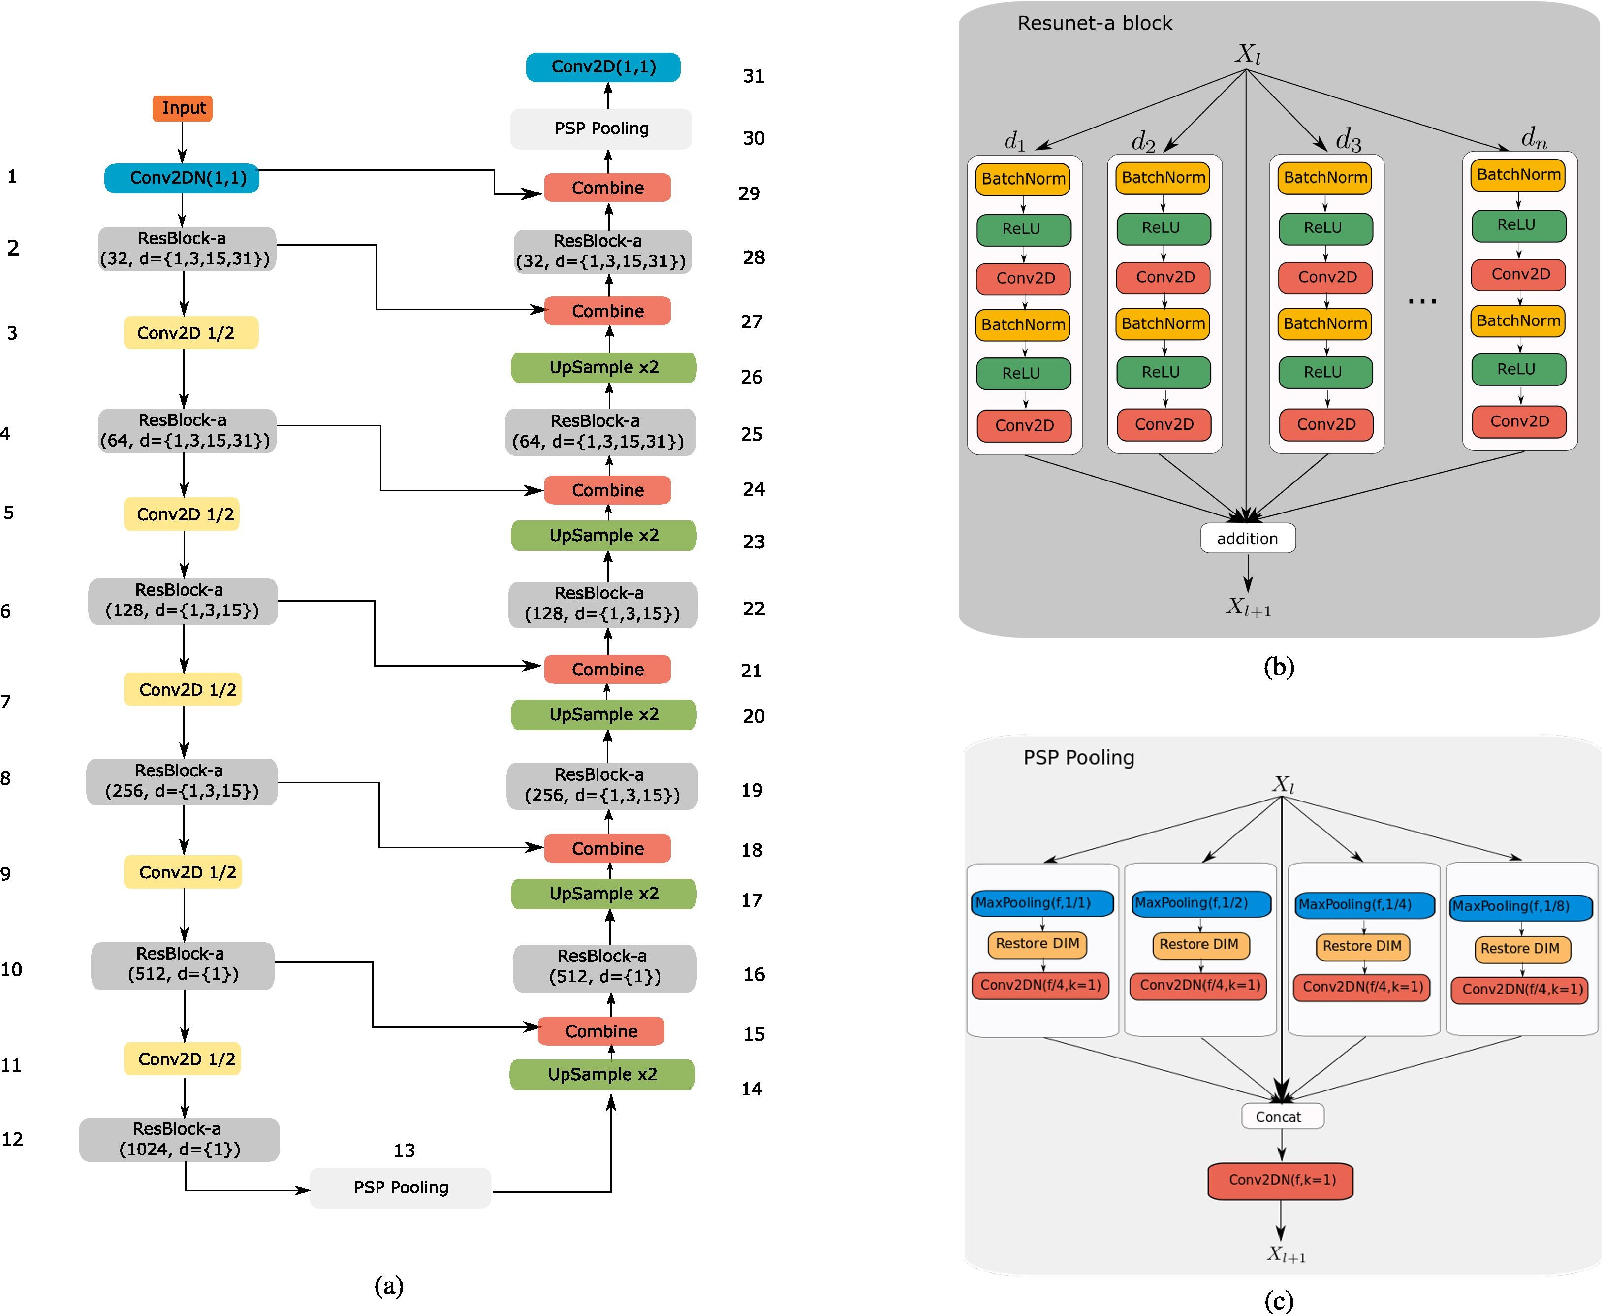
ResUNet
Overview of the ResUNet-a d6 network.
The left (downward) branch is the encoder part of the architecture. The right (upward) branch is the decoder. The last convolutional layer has as many channels as there are distinct classes.
Building block of the ResUNet-a network. Each unit within the residual block has the same number of filters with all other units. Here designate different dilation rates.
Pyramid scene parsing pooling layer. Pooling takes place in 1/1, 1/2, 1/4 and 1/8 portions of the original image.

Slide 15
Result of improvised Model

Slide 16
Comparing results

Slide 17
Conclusion

Slide 18
References
Yashvardhan Jain, Katy Borner, Claire Walsh, Nancy Ruschman, Peter D. Lee, Griffin M. Weber, Ryan Holbrook, Addison Howard. (2023). SenNet + HOA - Hacking the Human Vasculature in 3D. Kaggle. https://kaggle.com/competitions/blood-vessel-segmentation
Xiao, X., Lian, S., Luo, Z., & Li, S. (2018, October). Weighted res-unet for high-quality retina vessel segmentation. In 2018 9th international conference on information technology in medicine and education (ITME) (pp. 327-331). IEEE.
Diakogiannis, F. I., Waldner, F., Caccetta, P., & Wu, C. (2020). ResUNet-a: A deep learning framework for semantic segmentation of remotely sensed data. ISPRS Journal of Photogrammetry and Remote Sensing, 162, 94-114.
SenNet + HOA - Hacking the Human Vasculature in 3D Datset, https://www.kaggle.com/competitions/blood-vessel-segmentation/data
SenNet + HOA - Hacking the Human Vasculature in 3D Model, https://www.kaggle.com/competitions/blood-vessel-segmentation/models
He, K., Zhang, X., Ren, S., & Sun, J. (2016). Deep residual learning for image recognition. In Proceedings of the IEEE conference on computer vision and pattern recognition (pp. 770-778).
Diakogiannis, F. I., Waldner, F., Caccetta, P., & Wu, C. (2020). ResUNet-a: A deep learning framework for semantic segmentation of remotely sensed data. ISPRS Journal of Photogrammetry and Remote Sensing, 162, 94-114.

